Slide 1
How can a coordinate plane help us see patterns in real-world situations?

Slide 2
In this lesson you will learn how to recognize patterns by comparing and graphing them on a coordinate plane.

Slide 3
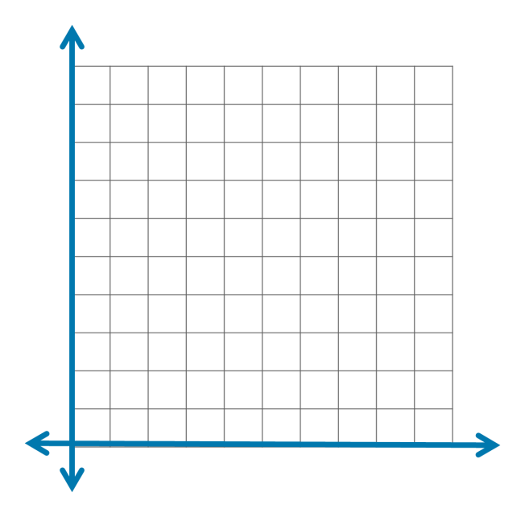
Graphing on a Coordinate Plane
Y Axis
10
9
Ordered Pairs
(x,y)
8
7
6
(1,3)
5
(2,6)
4
(3,9)
3
2
1
X Axis
0
2
1
3
4
5
6
7
8
9
10

Slide 4
Reggie bought 2 movie tickets for a total of $14. Cady bought 4 movie tickets for a total of $28. Create a table to show the pattern of the prices of the movie tickets. How much is 1 ticket? How much are 3 tickets? Graph the corresponding terms as ordered pairs on a coordinate plane. What pattern do you see?

Slide 5
Ticket Cost
Reggie
Cady
2 tickets for $14
4 tickets for $28
14 ÷ 2 = $7
28 ÷ 4 = $7
1 Ticket = $7

Slide 6
Reggie bought 2 movie tickets for a total of $14. Cady bought 4 movie tickets for a total of $28. Create a table to show the pattern of the prices of the movie tickets. How much is 1 ticket? How much are 3 tickets? Graph the corresponding terms as ordered pairs on a coordinate plane. What pattern do you see?

Slide 7
Ticket Cost
The terms in the 2nd set are 7 times the terms in the 1st set.
Tickets | Cost $
1
X7 =
7
2
X7 =
14
3
X7 =
21
4
X7 =
28

Slide 8
Ticket Cost
Each ticket is $7.
Tickets | Cost $
1
X7 =
7
1 ticket for $7
2
X7 =
14
3
X7 =
21
3 tickets for $21
4
X7 =
28

Slide 9
Reggie bought 2 movie tickets for a total of $14. Cady bought 4 movie tickets for a total of $28. Create a table to show the pattern of the prices of the movie tickets. How much is 1 ticket? How much are 3 tickets? Graph the corresponding terms as ordered pairs on a coordinate plane. What pattern do you see?

Slide 10
Create Ordered Pairs
Ordered Pairs
(x,y)
Tickets | Cost $
1
7
(1,7)
2
14
(2,14)
3
21
(3,21)
4
28
(4,28)

Slide 11
Graph the Ordered Pairs.
Y Axis
30
Ordered Pairs
(x,y)
27
24
(1,7)
21
(2,14)
18
(3,21)
15
(4,28)
12
9
6
X Axis
3
0
1
2
3
4
5
6
7
8
9
10

Slide 12
Reggie bought 2 movie tickets for a total of $14. Cady bought 4 movie tickets for a total of $28. Create a table to show the pattern of the prices of the movie tickets. How much is 1 ticket? How much are 3 tickets? Graph the corresponding terms as ordered pairs on a coordinate plane. What pattern do you see?

Slide 13
What pattern do you see?
Y Axis
30
Ordered Pairs
(x,y)
27
24
+7
(1,7)
21
The cost increases by $7 for each ticket bought.
+1
(2,14)
18
+7
(3,21)
15
+1
(4,28)
12
9
+7
6
+1
X Axis
3
0
1
2
3
4
5
6
7
8
9
10

Slide 14
Confusing the X Axis with the Y Axis
10
9
Ordered Pairs
(x,y)
8
7
6
(1,3)
5
(2,6)
4
(3,9)
3
2
1
0
2
1
3
4
5
6
7
8
9
10

Slide 15
Confusing the X Axis with the Y Axis
Y Axis
10
9
Ordered Pairs
(x,y)
Ordered Pairs
(x,y)
8
7
(1,3)
6
(1,3)
(2,6)
5
(2,6)
4
(3,9)
(3,9)
3
2
1
0
X Axis
1
2
3
4
5
6
7
8
9
10

Slide 16
In this lesson you have learned how to recognize patterns by comparing and graphing them on a coordinate plane.

